Slide 1


VITB-JHU Health-Hack 2026
Problem Statement Title : Health Risks That Hide in Plain Sight
Theme : ASHA-Driven Digital Health: Predictive, Preventive & Connected
Category : SOFTWARE
Team Name : MATERNOVA
University Name : VIT BHOPAL UNIVERSITY

Slide 2


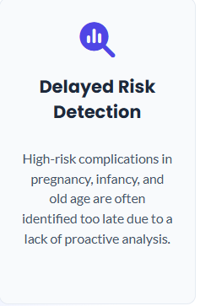





The Problem: A Fragmented & Reactive System
Fragmented Data
Delayed Risk Detection
Disconnected Care Teams
Emergency Response Gaps
Manual, paper-based records are slow, prone to errors, and inaccessible in emergencies, creating data silos.
High-risk complications in pregnancy, infancy, and old age are often identified too late due to a lack of proactive analysis.
Doctors, ASHA workers, and caretakers lack a single source of truth, leading to communication gaps and missed checkups.
Caretakers lack immediate, reliable guidance during critical emergencies before professional help can arrive.

Slide 3








Our Solution: A Unified Digital Ecosystem
Digital Data Capture
AI-Powered Insights
Connected Care Portals
Instant Emergency Module
A simple app for ASHA workers to collect vital health data (offline & online) for women, infants, and the elderly.
An AI engine analyzes data to provide early risk alerts, simple medication suggestions, and lifestyle precautions.
Dedicated portals for doctors (to supervise & intervene) and caretakers (to view precautions & reminders).
Provides immediate first-aid instructions and voice guidance to caretakers during critical health emergencies.

Slide 4




Our Uniqueness & Innovation
From Reactive to Proactive: The AI predicts risk *before* it becomes critical. It suggests preventative actions, not just logs data, moving healthcare from reactive to proactive.
The 360° Care Loop: This is the first system to connect the ASHA worker, doctor, and caretaker in a single, real-time feedback loop under NGO/doctor supervision.
Empowering ASHA Workers: The platform elevates ASHA workers from simple data collectors to digitally-empowered community health advocates with AI-backed insights.
Closing the Emergency Gap: The integrated emergency module provides critical, life-saving guidance in the crucial minutes *before* professional help can arrive.

Slide 5











Core Technology Stack
Front-end
Back-end
Database
AI / ML
React Native, Flutter, HTML5, CSS3, JS
Python/Django, Node.js, Java/Spring Boot
PostgreSQL, MongoDB, MySQL
TensorFlow, PyTorch, scikit-learn, NLP frameworks
Cloud Services
Security
DevOps
AWS, Google Cloud, Azure
OAuth2, JWT, SSL/TLS, AES-256 encryption
Docker, Kubernetes, CI/CD pipelines, Prometheus/Grafana

Slide 6



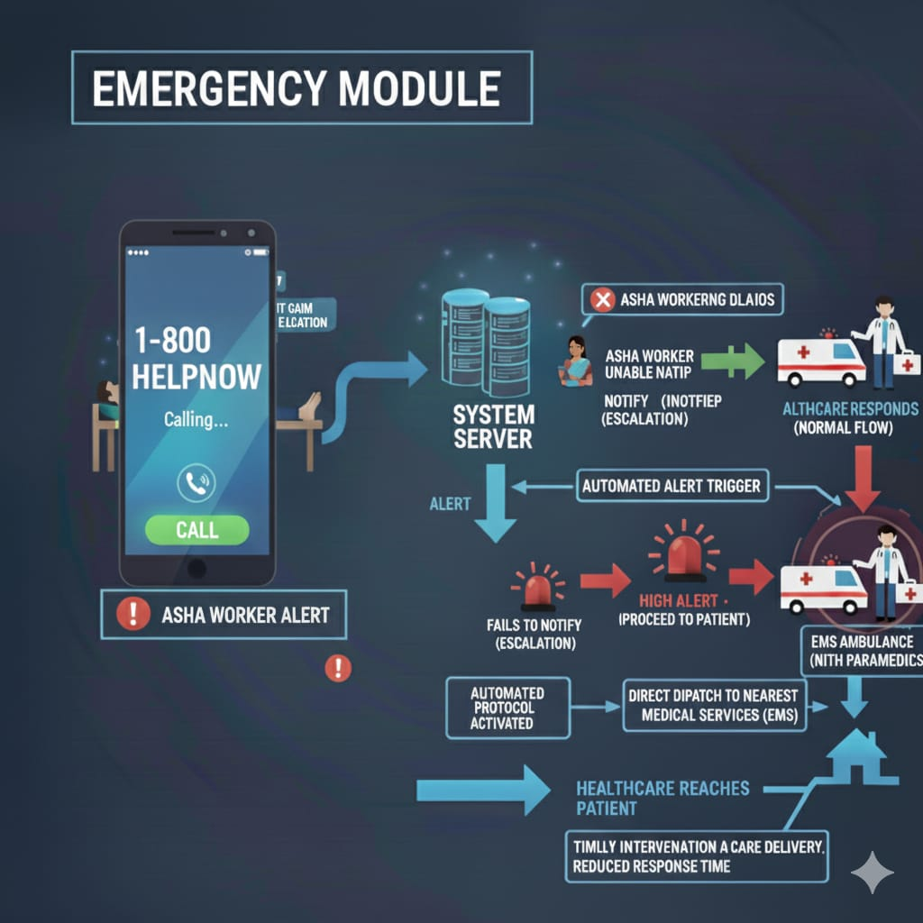

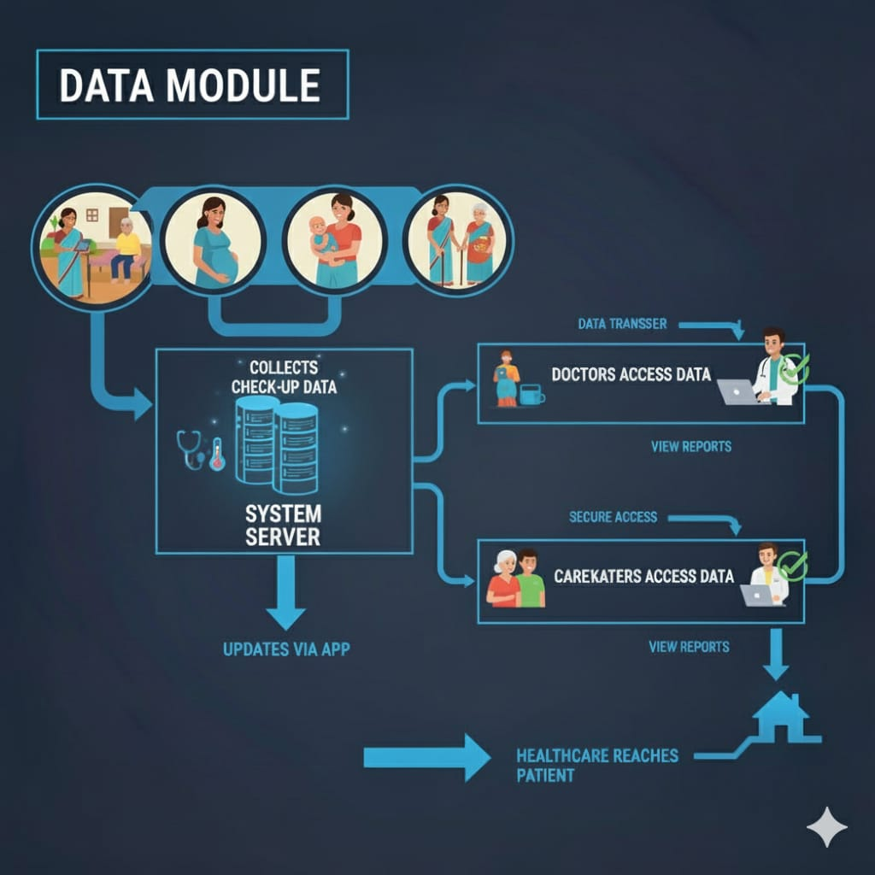

Project Modules Overview
Emergency Module
Data Module

Slide 7



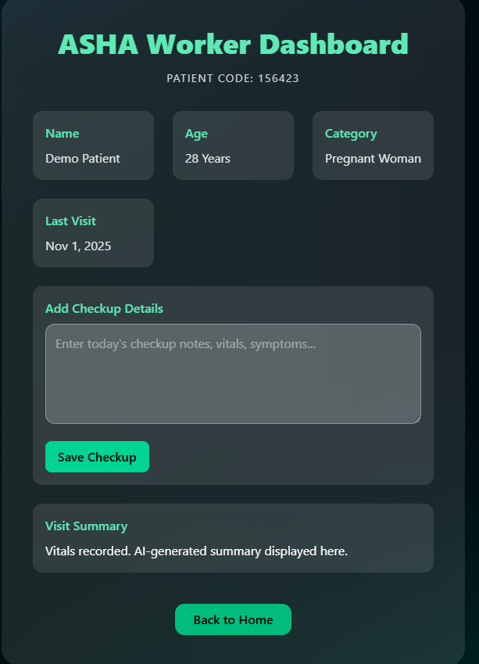
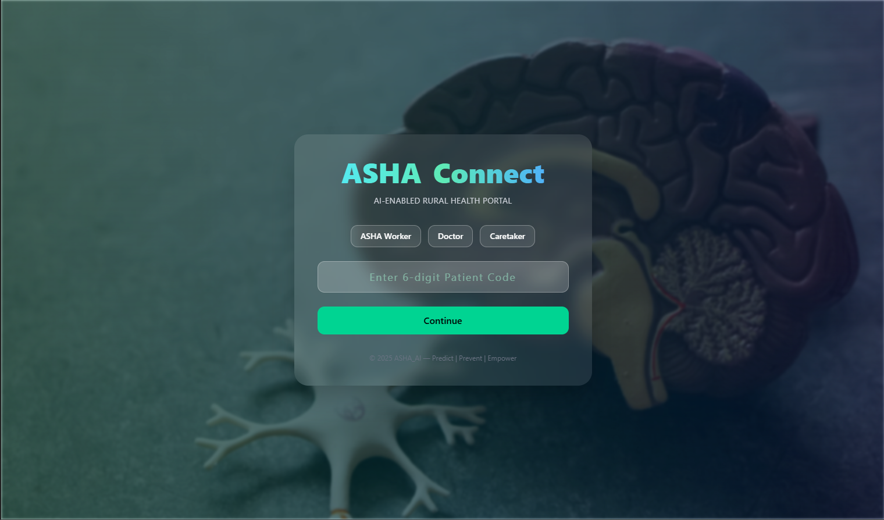
The ASHA Connect Workflow: Entry & Data Collection
1. Secure, Role-Based Access
2. AASHA Data Collection
The platform begins with a simple login. Users identify as an ASHA Worker, Doctor, or Caretaker and use a 6-digit Patient Code, ensuring secure and role-specific access.
AASHA workers use a clean dashboard to manage patients. They can view key patient info and easily add new checkup details, vitals, and symptoms directly from the field.

Slide 8
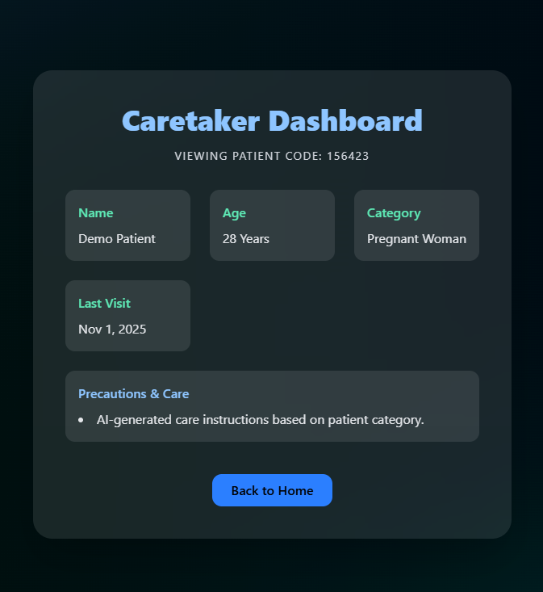
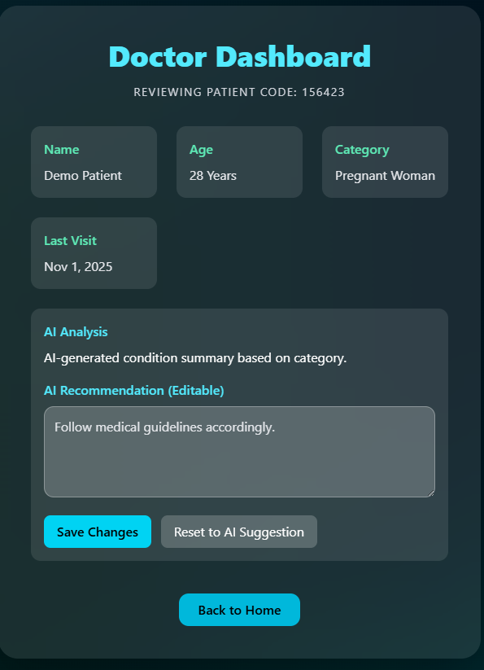
The AI-Powered Care Loop: Analysis & Delivery
3. AI Analysis & Doctor Supervision
4. Actionable Caretaker Guidance
The Doctor Dashboard displays the AI's analysis and a suggested recommendation. The doctor has full control to review, edit, and approve the final care plan, ensuring clinical accuracy.
The Caretaker Dashboard provides a simplified view of the doctor-approved "Precautions & Care" instructions. This closes the loop, delivering actionable health advice to the patient's home.

Slide 9
Project Implementation Roadmap
M4: AI & Emergency Support
M2: UI/UX & Database
M6: Launch & Optimization
Activities: Designing UI, database schemas, cloud setup. Deliverables: UI mockups, DB/API architecture.
Activities: Build AI for risk alerts, create emergency module. Deliverables: AI Model v1, Emergency Support v1.
Activities: Full deployment, fix pilot issues, add multilingual support. Deliverables: Platform launch, support setup.
M1: Requirements & Blueprint
M3: Core Backend Dev
M5: Testing & Field Pilot
Activities: ASHA module, patient codes, basic dashboards. Deliverables: Working backend, basic connectivity.
Activities: Functional/usability testing, AI accuracy testing, pilot in 1-2 villages. Deliverables: Tested system, pilot report.
Activities: ASHA workflows, health metrics, system blueprint. Deliverables: Requirements Doc, flowcharts.

Slide 10
Key Success Factors
Partnership: Strong government and NGO partnerships are essential for scale, legitimacy, and successful integration.
Doctor Buy-In: Active supervision and buy-in from medical professionals ensures clinical value and proper oversight.
Simple UI/UX: The interface must be simple and intuitive for high adoption by ASHA workers, doctors, and caretakers.
Emergency Integration: Reliable, fast integration with emergency response is critical for building user trust and saving lives.
Training & Support: Continuous training and support are required to maintain data quality and ensure user engagement.

Slide 11



Impact Metrics & Feasibility
Expected Impact Metrics
Overall Feasibility Rating
25-35%
8.5/10
30-40%
Reduction in missed checkups
Improvement in early detection
Highly Feasible
The project addresses critical healthcare gaps by leveraging existing ASHA worker infrastructure, with a clear path to improving community health outcomes through phased implementation.
50-60%
40-50%
Faster emergency guidance
Reduction in manual record time

Slide 12
Mitigation Strategies: Field, System & Technical
Challenge | Core Strategy | Enhancement Tactic
Digital Literacy | Simple UI/UX design & comprehensive training for ASHA workers & doctors (M5). | Implement gamification and performance incentives for accurate and consistent data submission.
Network & Connectivity | Mobile app development (M2) with real-time sync capabilities (M3). | Mandate an "Offline-First" architecture to queue data locally. Use SMS/USSD fallback for critical alerts.
Security & Privacy | Full-stack encryption & security (OAuth2, JWT, SSL/TLS, AES-256) on AWS/GCP/Azure. | Enforce strict Role-Based Access Control (RBAC) to ensure users only see data necessary for their role.
Emergency Liability | Emergency module with first-aid instructions and voice guidance (M4). | Include clear, legally-reviewed disclaimers. Ensure all guidance is validated. Geo-locate nearest facility.

Slide 13
Mitigation Strategies: Data & AI
Challenge | Core Strategy | Enhancement Tactic
Data Quality | Patient code generation (M3) and active doctor supervision (Feasibility). | Implement smart input validation (e.g., flag impossible vitals) and an anomaly detection layer.
AI Trust & Validation | AI accuracy testing with doctors (M5) and using doctor-approved recommendations (M4). | Adopt Explainable AI (XAI) to show simple context for predictions (e.g., "Risk high due to...").
Contextual Relevance | AI built specifically for pregnancy, infant, and elderly risk models (M4). | Focus initial AI training on a Minimum Viable Dataset (M1) from the pilot region first.

Slide 14
Mitigation Strategies: NGO Funding & Sustainability
Challenge | Core Strategy | Funding/Partnership Tactic
Initial Development Cost | Develop a lean MVP (M1-M6) using open-source technology to keep initial costs low. | Secure "Innovation Grants" for the pilot. Aggressively pursue "Tech for Good" programs (AWS, Google) for free cloud credits.
Field Hardware & Data | Pilot (M5) to establish a clear cost-per-user, which informs grant applications. | Engage telecom/hardware companies for **CSR partnerships**. Co-author proposals with government to bundle device costs.
Long-Term Sustainability | Track "Impact Metrics" (M6) to build a powerful **Social Return on Investment (SROI)** report. | Use the SROI report to secure long-term operational grants from government (e.g., NHM) & large philanthropic foundations.

